Slide 1
Cricket live score Management
Created By
G.Dinesh
Project Guide
Mrs A.Mareeswari MCA, M.Phil, PGDCA.,

Slide 2
Abstract
Cricket Score Management System is about showing live scores of the cricket match in online mode. People may view the live scores at their working place through online mode. The proposed system “Cricket Score Management System” has an Admin who constantly updated the scores. The system also provides a timetable of all the matches that would be going to be held for users to know in prior about the matches.

Slide 3
Existing System
In existing system, Cricket Scores displayed on Board during cricket matches, watched through on the television. Most matches are not scheduled on holidays and this will allow people access to the match regardless of their location. Some sites do exist that display text commentary but they are very impersonal.

Slide 4
PROPOSED SYSTEM
Advantages:
The user can view the scores from anywhere through internet.
Users can keep themselves updated about matches.
The system is flexible to use and is cost-effective.
Disadvantages:
Internet connection is requisite for this system.
One cannot view live match if wishes.

Slide 5
Users
View Live Scores
View Batsman Score Board
View Bowler Score Board
View Upcoming Matches
View Points Table
View News

Slide 6
Admin
Creation
Create Tournaments
Create Teams
Create Player
Manage
Manage Tournaments
Manage Teams
Manage Players
Fixtures
Result
News

Slide 7
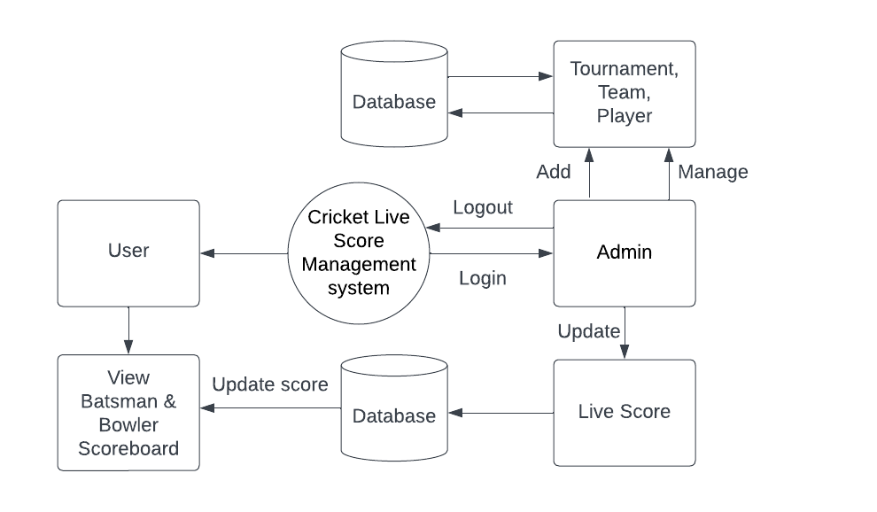
DATA FLOW DIAGRAM

Slide 8
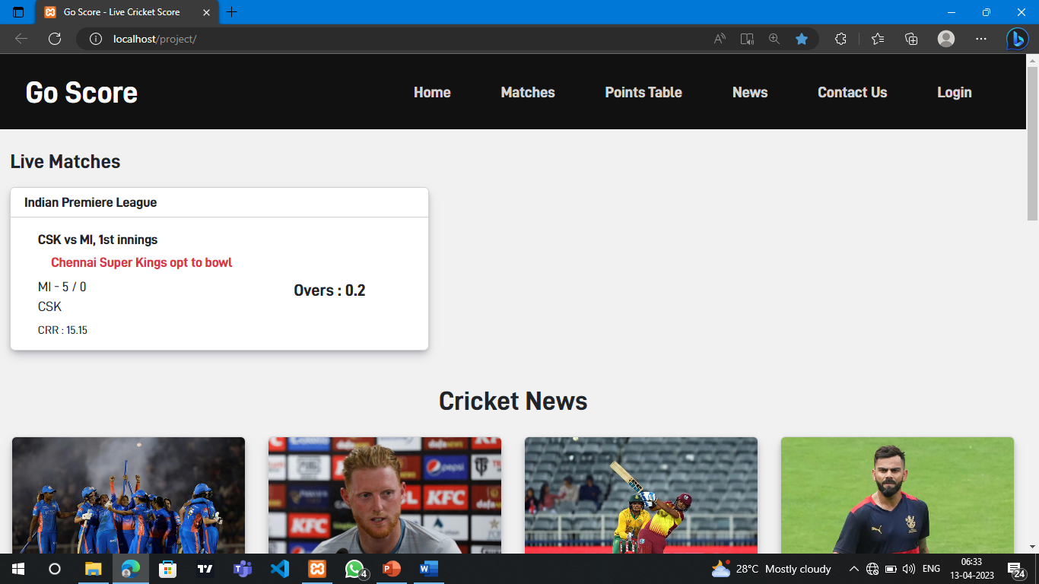
User page

Slide 9
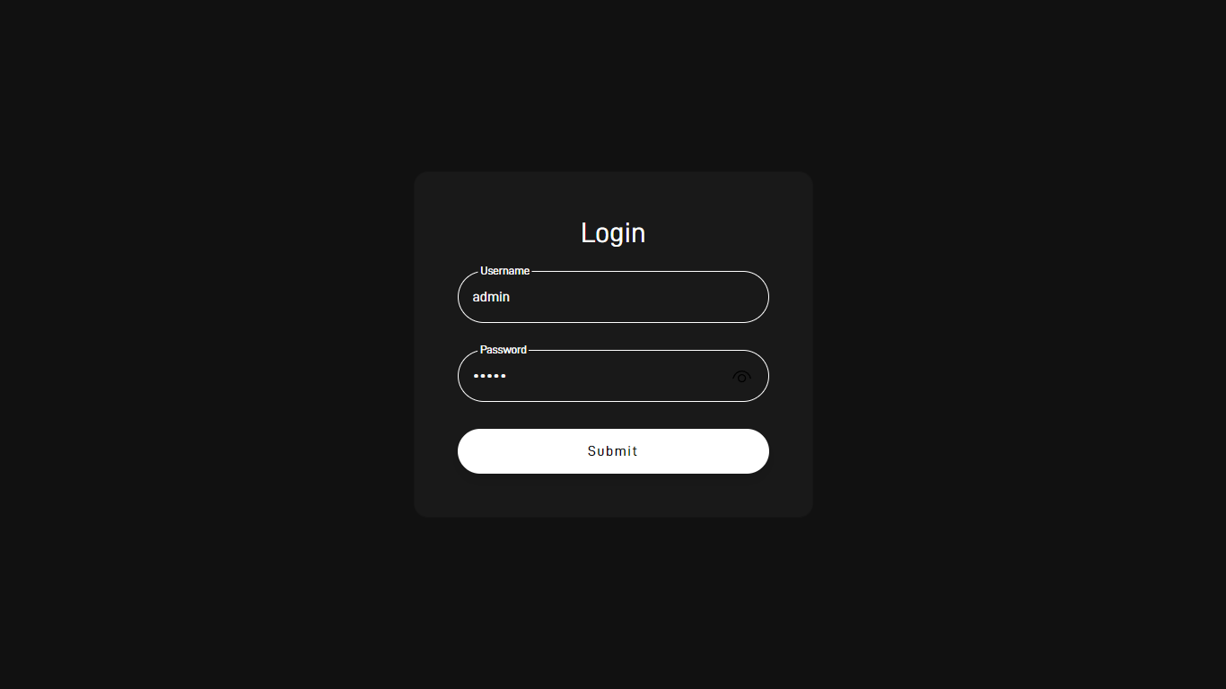
Login page

Slide 10
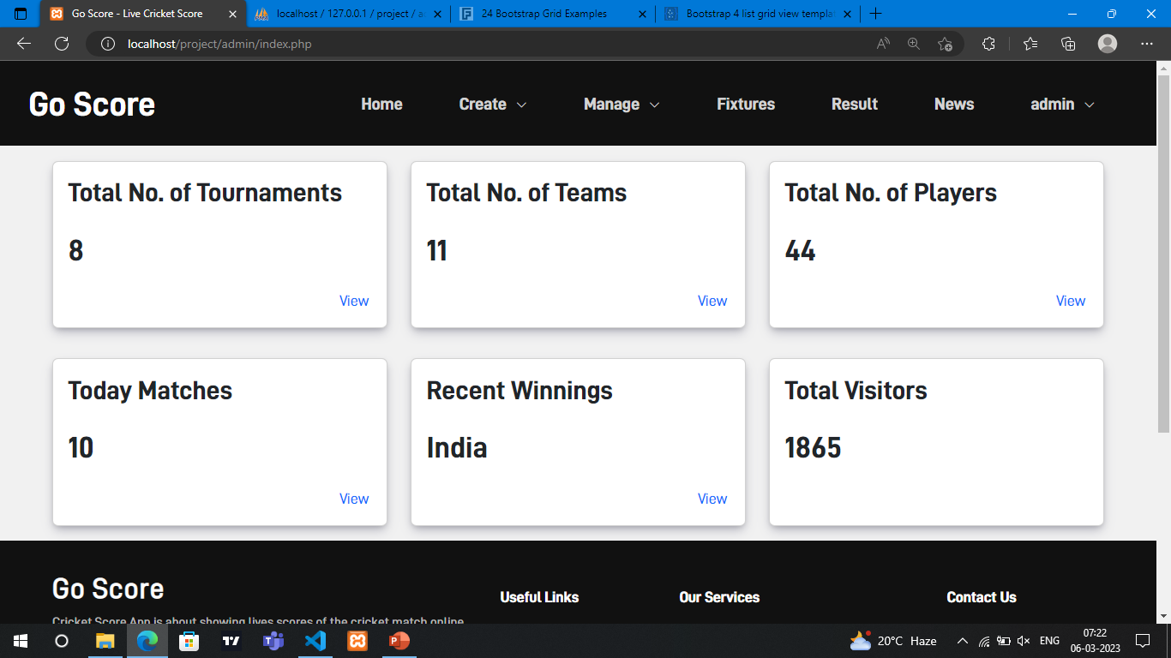
Admin page

Slide 11
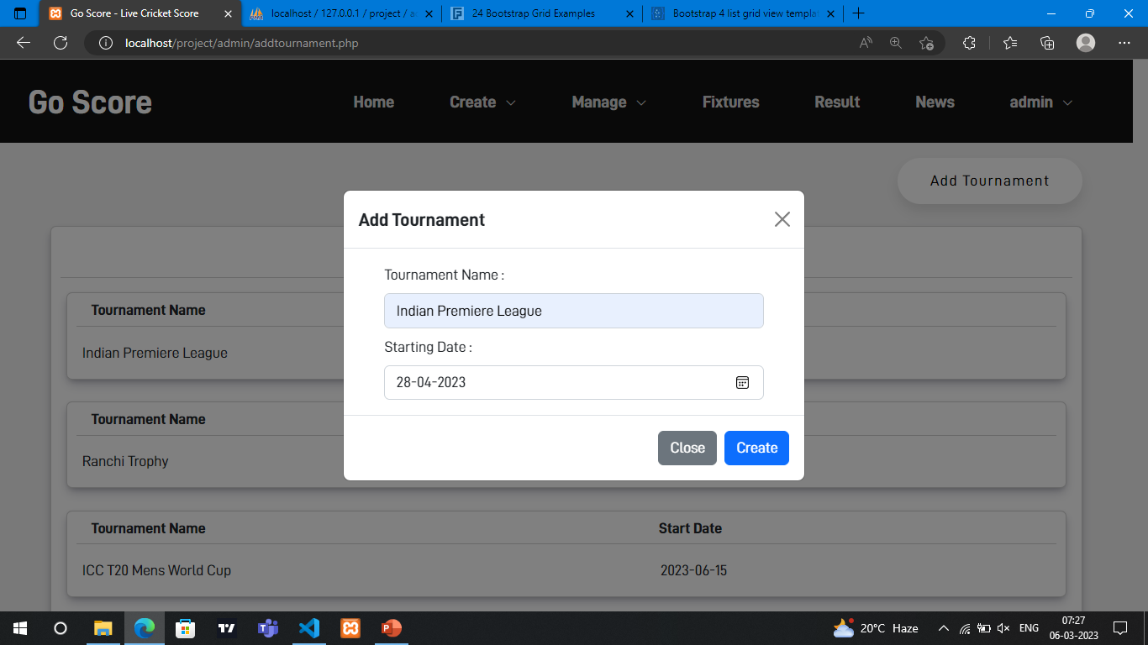
Tournament creation

Slide 12
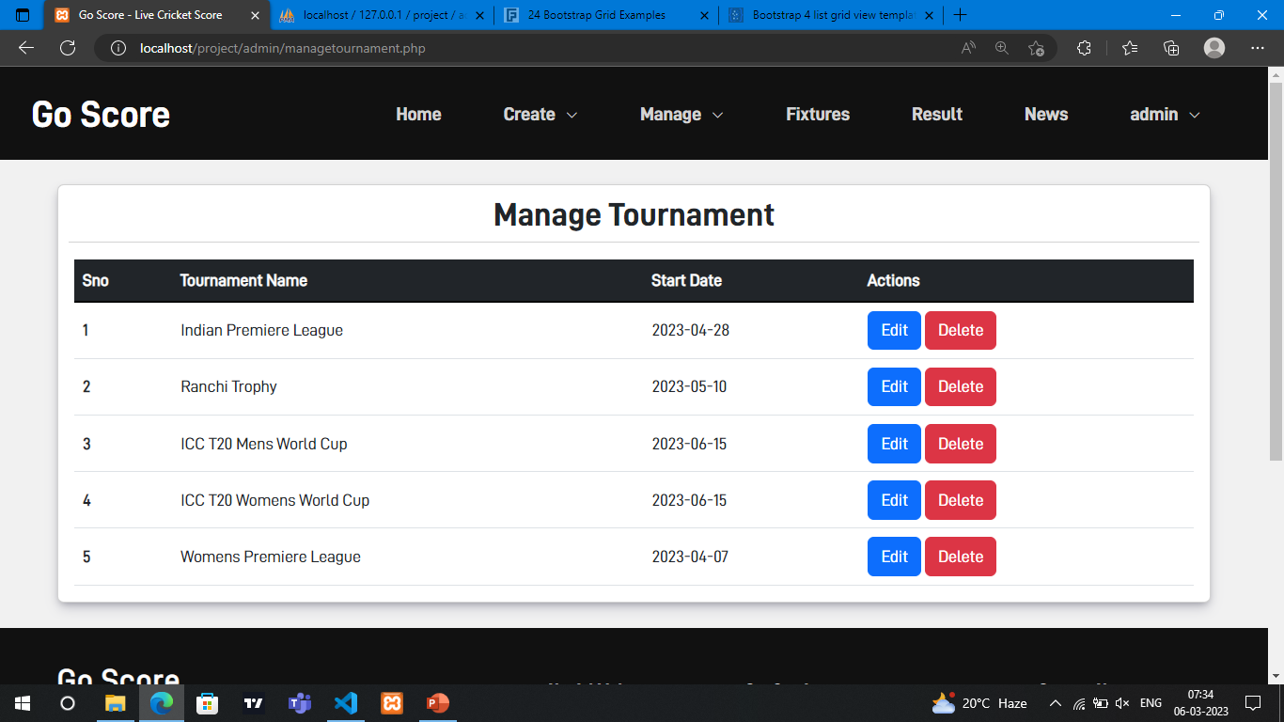
Manage tournament

Slide 13
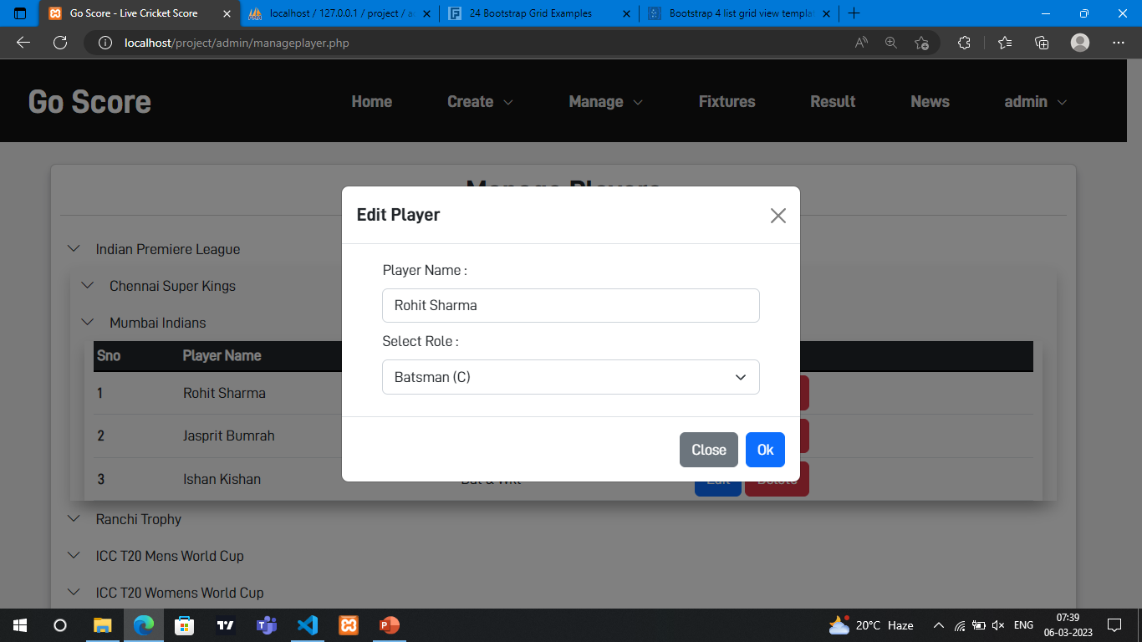
Edit records

Slide 14
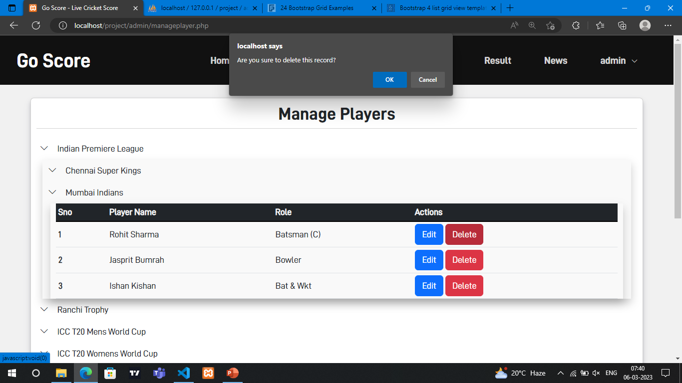
Delete records

Slide 15
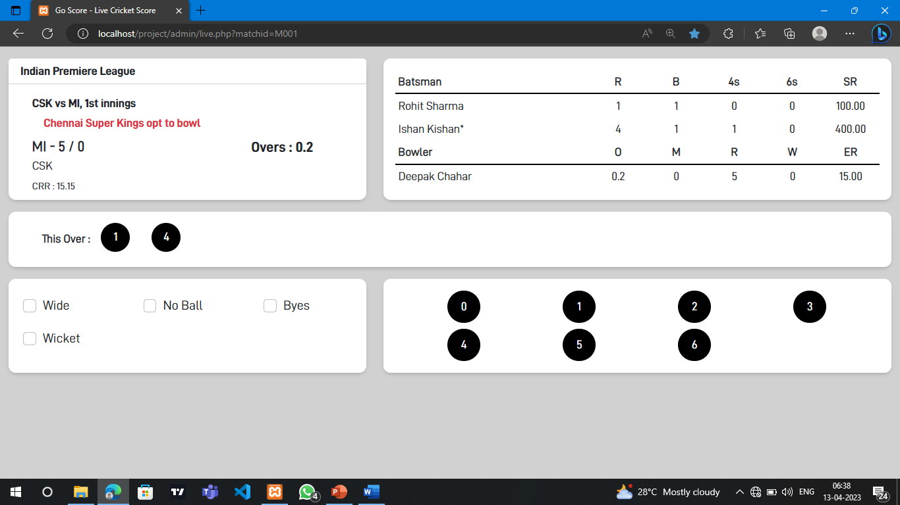
UPDATE SCORE

Slide 16
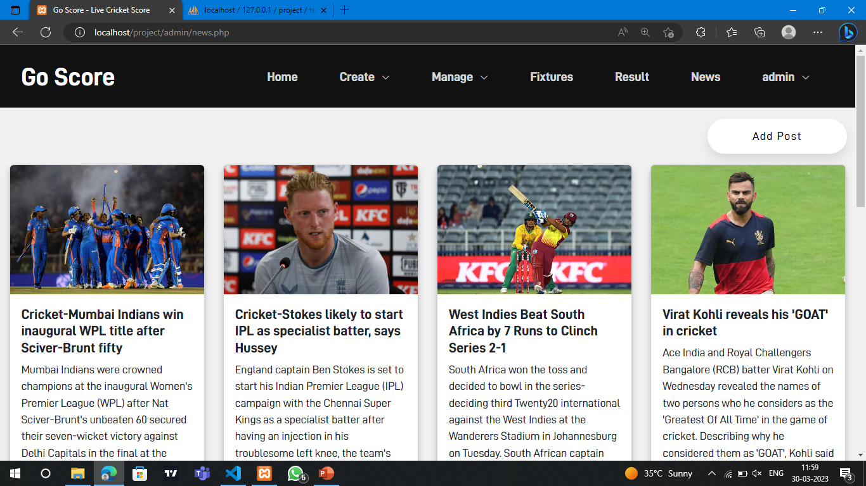
Add news

Slide 17
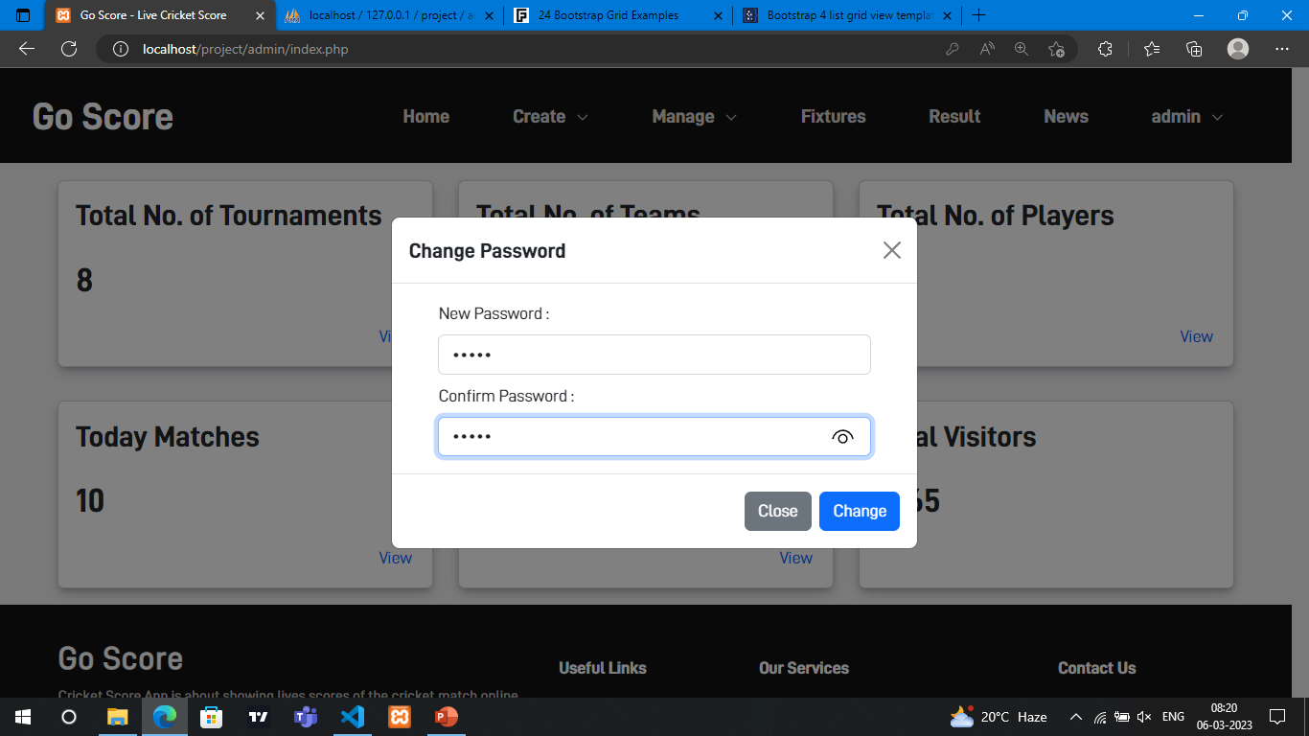
Change password

Slide 18
References:
Larry Ullman – PHP 6 MySQL 5 FOR DYNAMIC WEBSITES
Website References:
https://w3schools.com – FOR REFERENCES
https://getbootstrap.com - FOR BOOTSTRAP CLASSES

